Slide 1
Caching

Slide 2

Github
https://github.com/roblee32/cache_workshop_oct_2025

Slide 3
What is A cache?
Storing data in temporary storage
When to use it?
Frequently Accessed
Difficult to Generate

Slide 4
Benefits
Reduced Latency
Faster Overall Performance
Fewer DB queries

Slide 5
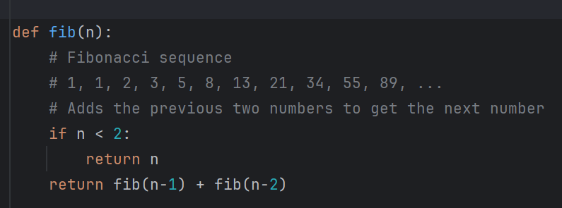
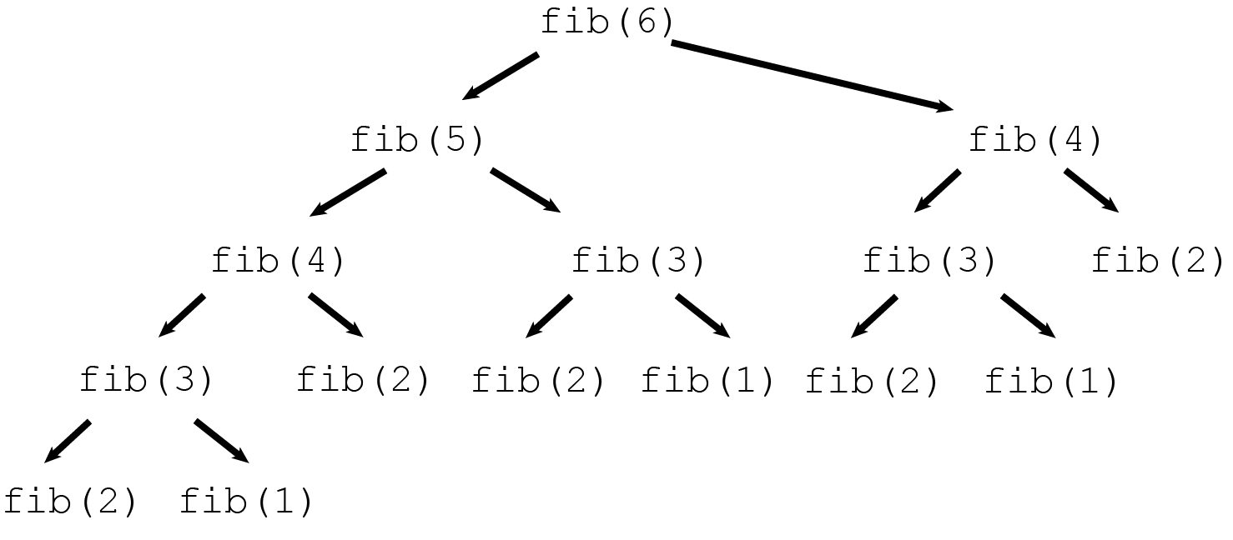
Python

Slide 6
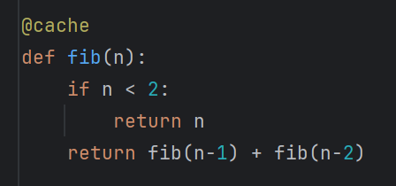
Python Caching
@cache decorator
Stores an unlimited number of values
Slightly faster than LRU cache
Uses an unlimited amount of memory!!

Slide 7
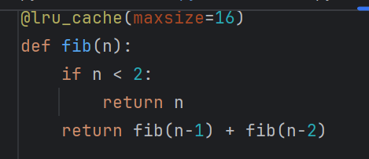
LRU Cache
@lru_cache decorator
Allows you to set an upper bound on the number of values stored
Least Recently Used strategy

Slide 8
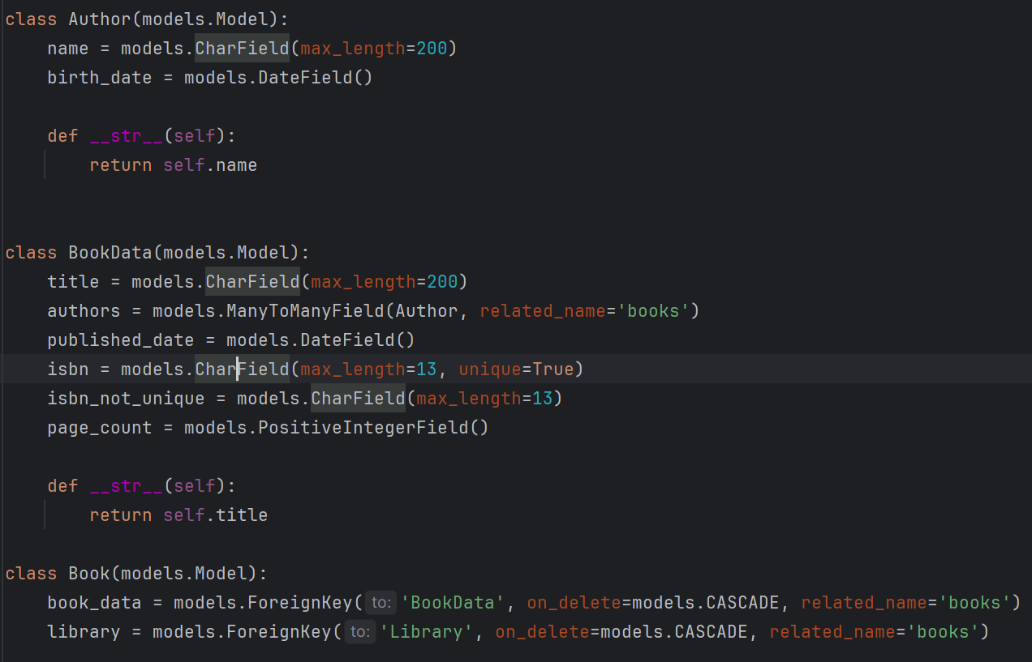
Caching In DJANGO
Making a return my Books app

Slide 9
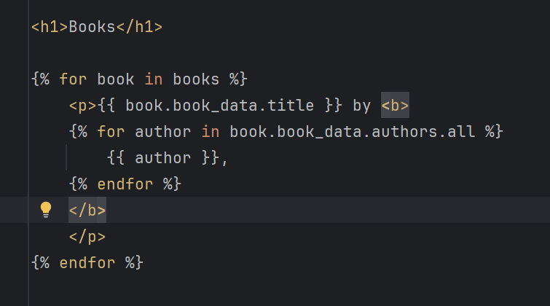
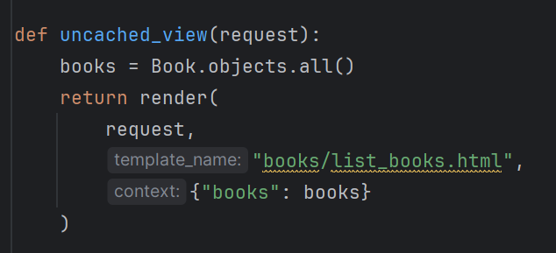
Template & View

Slide 10
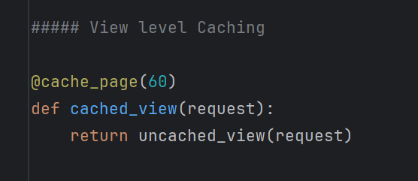
View based Caching
Keeps record of the output of this view up to the time limit set in the decorator. In this case 60 seconds
Avoids fetching the Books from the DB again
No overhead of having to render the template
Significant time savings on slow templates

Slide 11
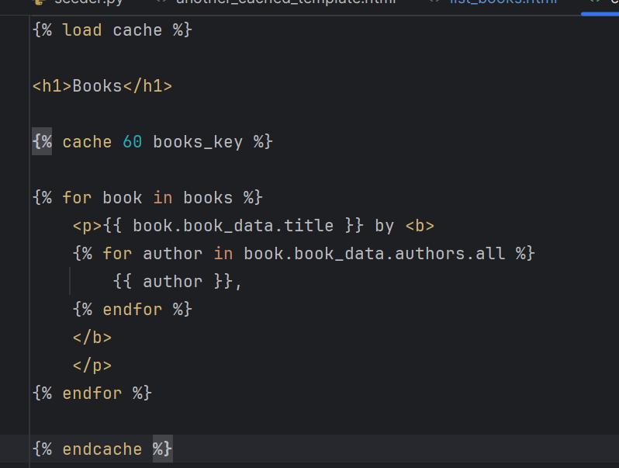
Template Fragments

Slide 12
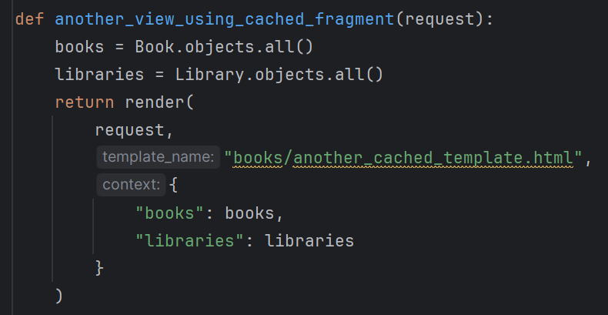
Template Fragments
Saves the output of a smaller section of the html
Same component is used across several views
Section of a view which will not change, but another that changes frequently or is different per user.

Slide 13
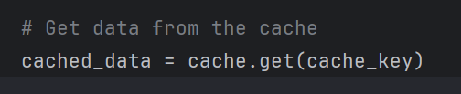
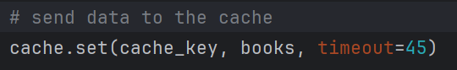
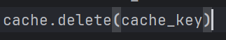
Fine Grained CachE
Get from cache using a key
Set data in the cache, setting a sensible timeout
Delete data from the cache

Slide 14
DjANGO Cache TYpes
In Memory Cache
Simple
Fast
Additional in process memory
File Cache
Stores values on disk
Persistent between server restarts
Slower
DB Cache
Caching in Database
Slower than dedicated cache
Good write performance
Redis
Requires dedicated setup
Persistent even on cache restart
High performance (slower than in memory due to network traffic)

Slide 15
Summary
Pros
Faster Response Times
Reduce Calculation Overheads
Cons
More Memory Usage
Additional Complexity

Slide 16
Further Reading
https://dev.to/pragativerma18/django-caching-101-understanding-the-basics-and-beyond-49p
https://docs.djangoproject.com/en/5.2/topics/cache/

